Slide 1

Mobile First, Xamarin First!
Vojtěch Mádr

Slide 2
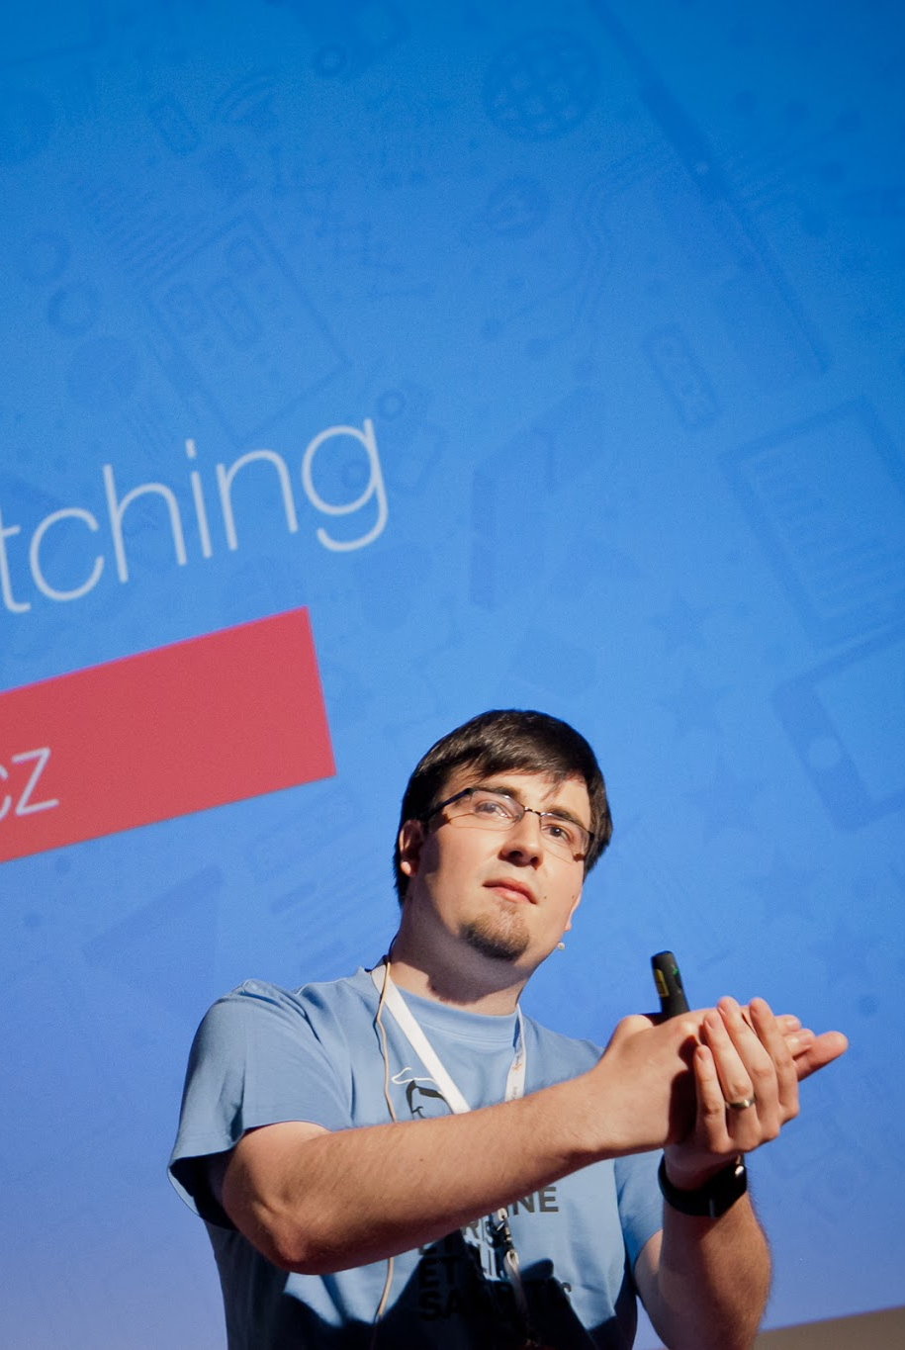
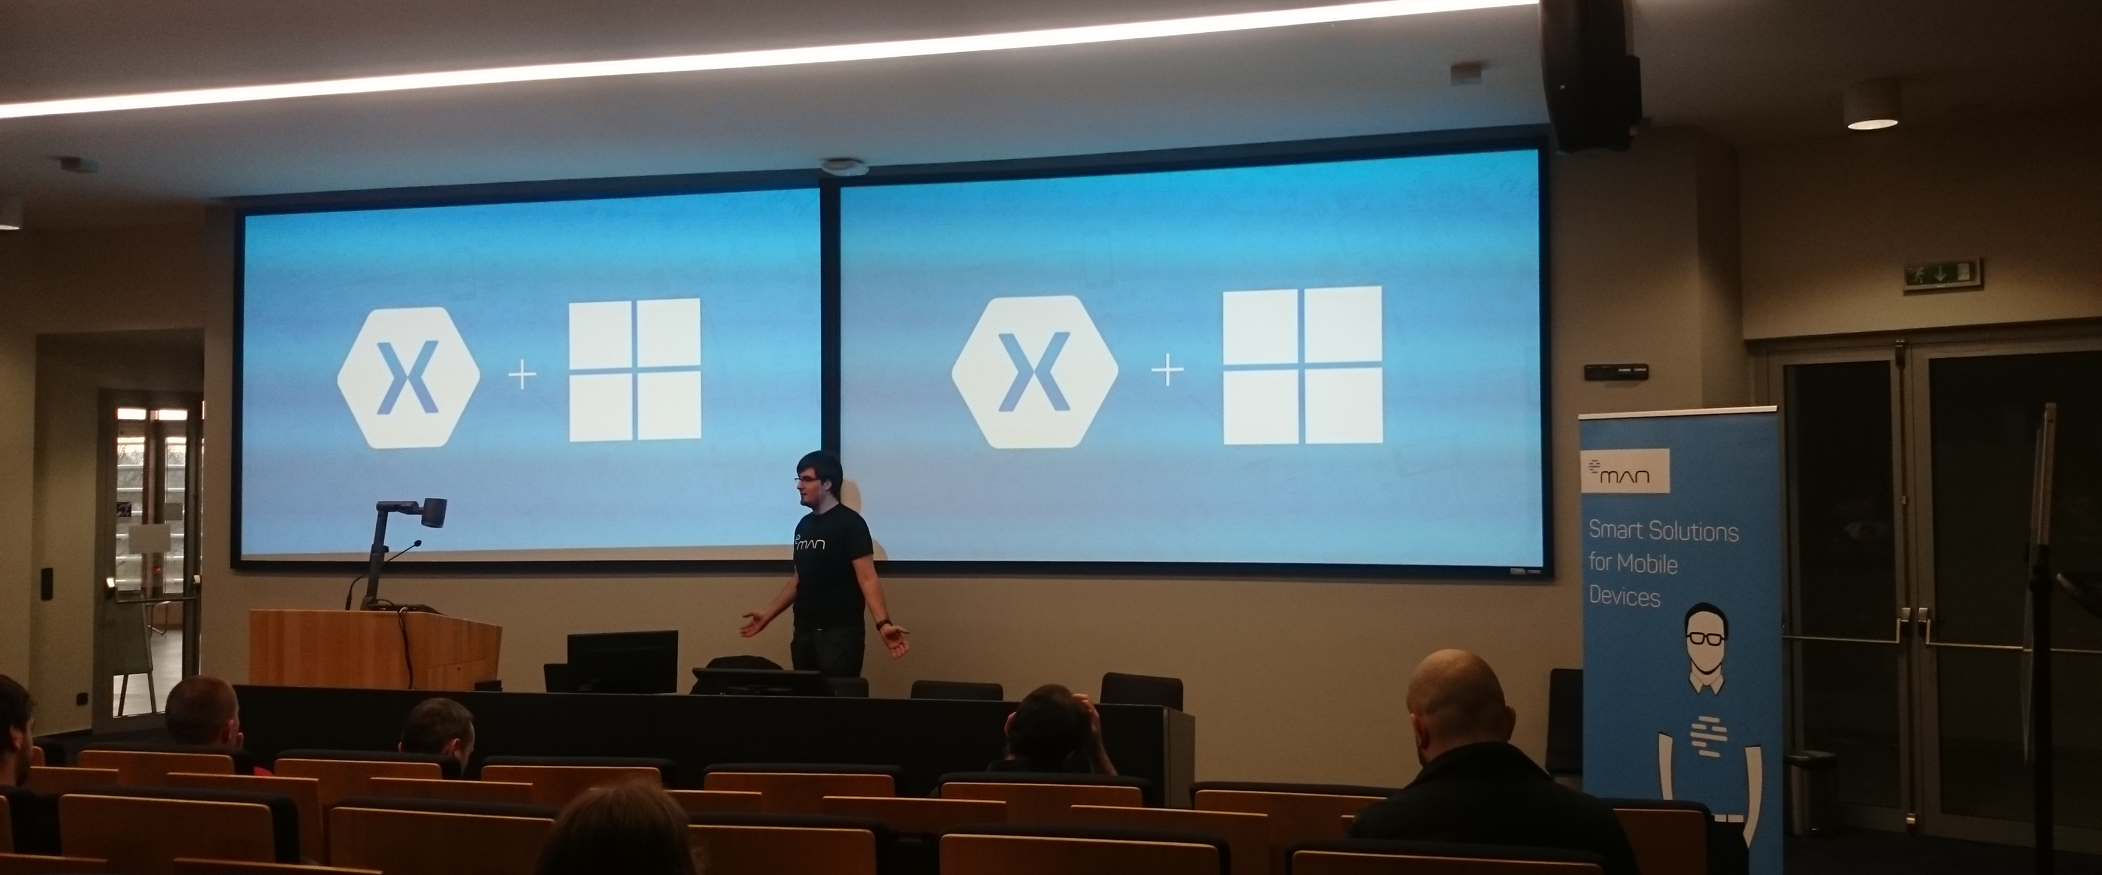
Senior Xamarin Developer in Worklio Microsoft MVP Founder of Xamarin Developers Group Czech Host in dotnetcz podcast

Slide 3
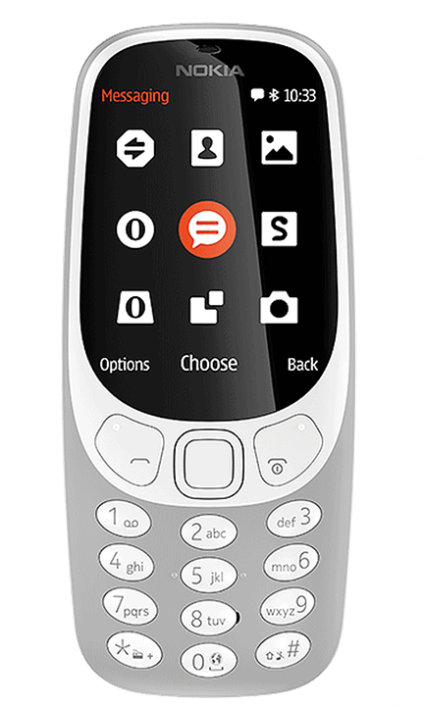
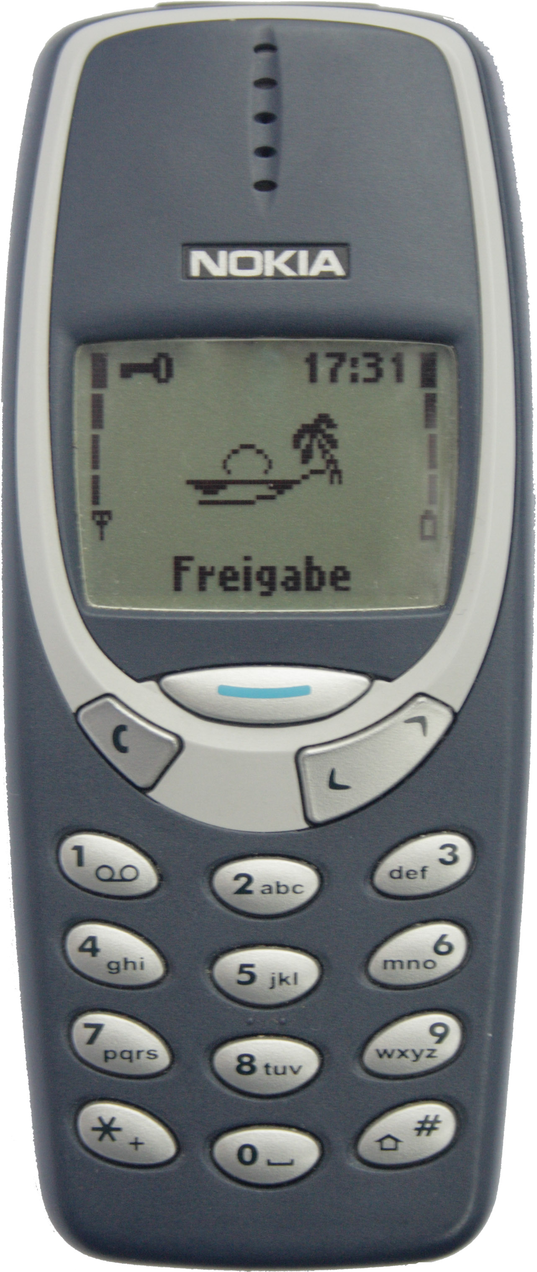
Notes:
Na Mobile World Congress největší zájem 3310

Slide 4
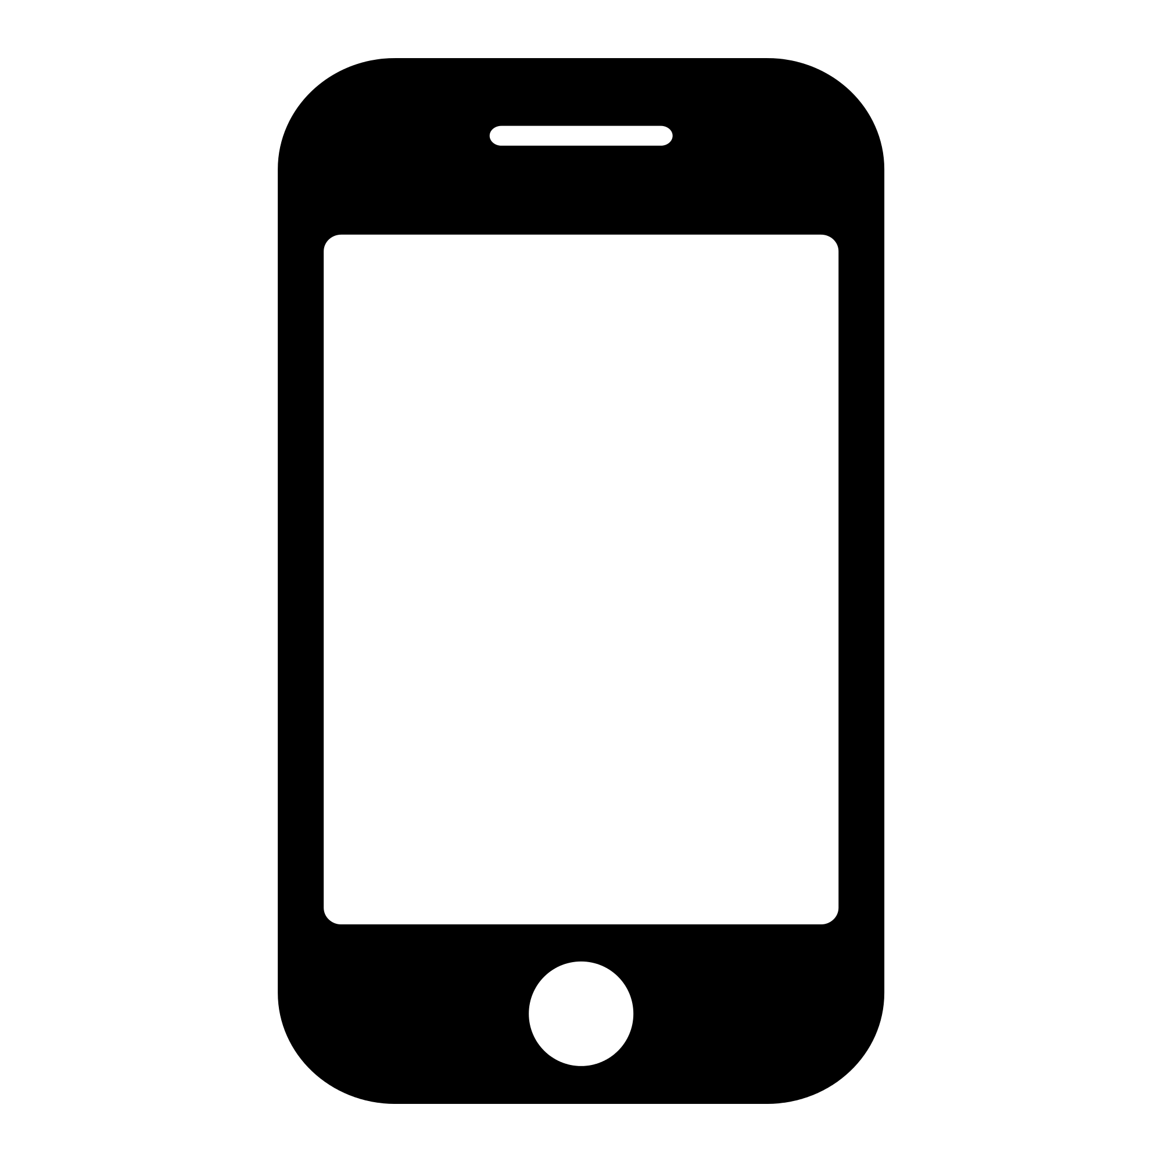

Mobile vs Web

Slide 5
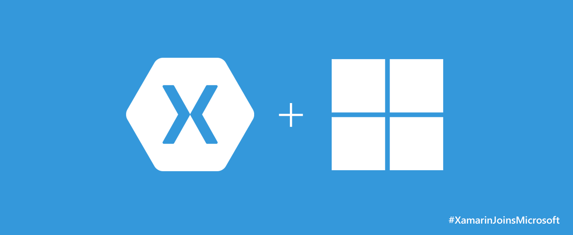

Slide 6
4 most mobile apps developers problems
UI (Android, iOS, Windows)
Reusing (Sharing) code
Teams and Peoples
Community

Slide 7
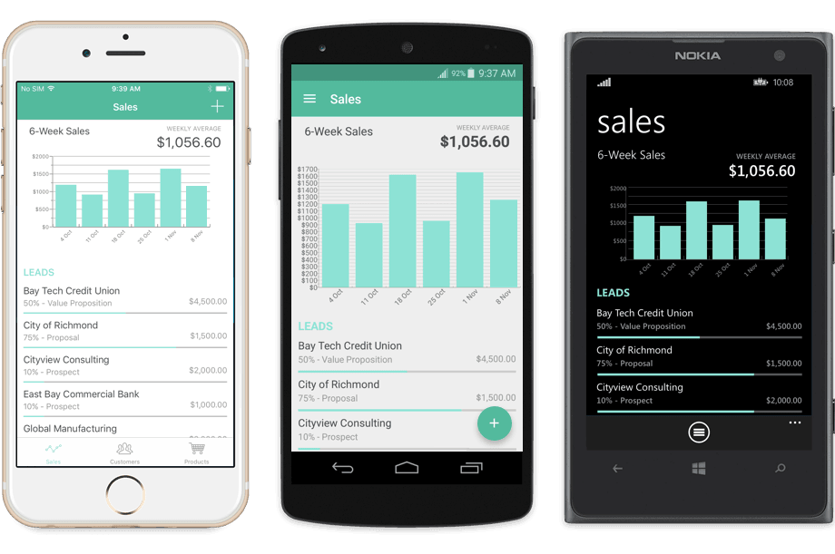
User interface
Nejde o to, aby to fungovalo, hlavně
aby to vypadalo!
What is native?
What is good UX??
What is good UI???
WHAT IS BEST EXPERIENCE FOR USER???

Slide 8
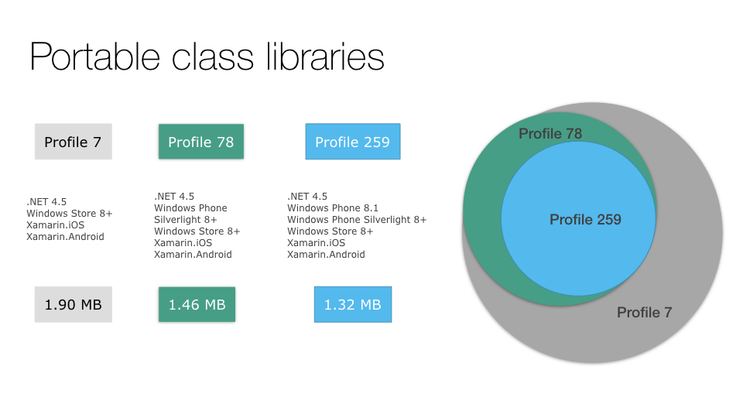
Reusing and sharing code
Saving work for next project
Architects
Problems with adapting to backend
Teams problems
Distribution

Slide 9
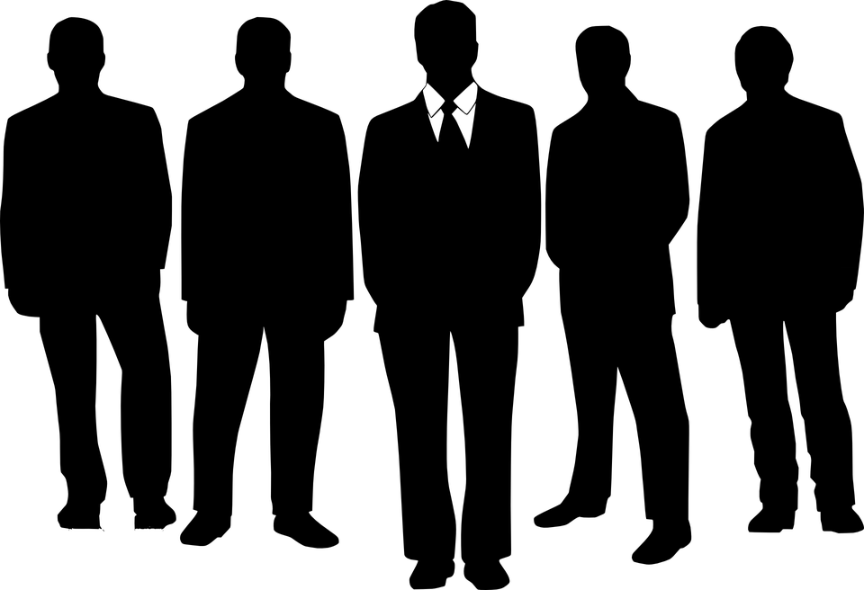
Teams and Peoples
VS

Slide 10
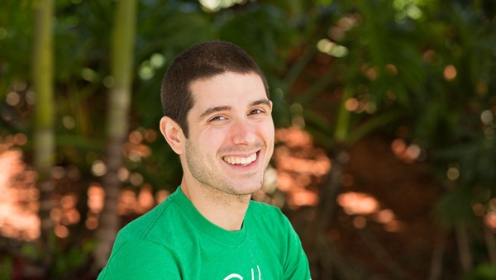
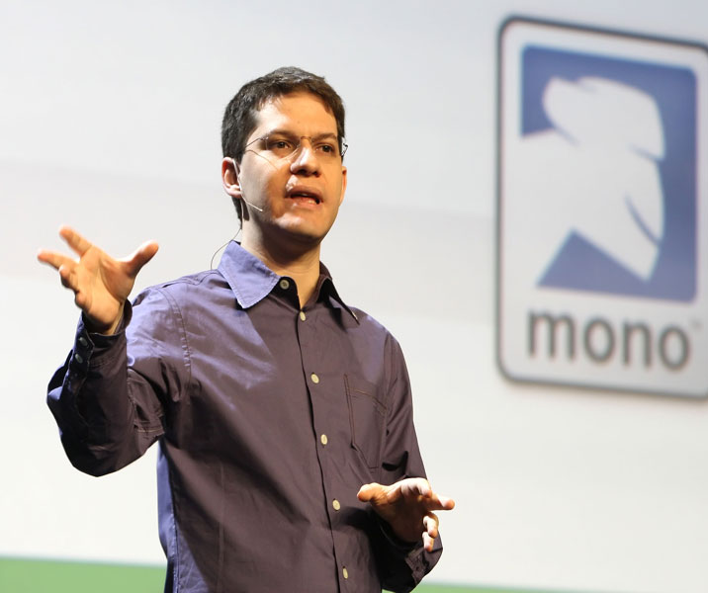
Community
Complex of JS
OpenSource?
Updates
Libraries
BUT ALL FRAMEWORKS IS ABOUT PEOPLES

Slide 11

Thanks for your time
https://www.meetup.com/xmdg-cz/
https://www.facebook.com/xmdgcz/
Twitters
@xmdg_cz
@madrvojt
@dotnetcezet

